Slide 1



Open_cv_projekt
Patai krisztián,csepregi máté,pozsár mátyás

Slide 2

Task assignments
We have divided the project into three different parts:
-License Plate Recognition: Máté Csepregi
-Document Scanner: Mátyás Pozsár
-Color Recognition Program: Krisztián Patai

Slide 3
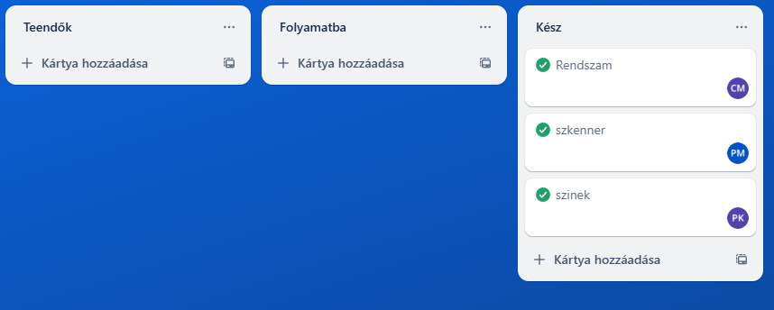
Project Manager Tools
Trello: Project Task Assignment and Workflow

Slide 4

What we used
Python programozási nyelv : - open cv könyvtár - numpy könyvtár

Slide 5

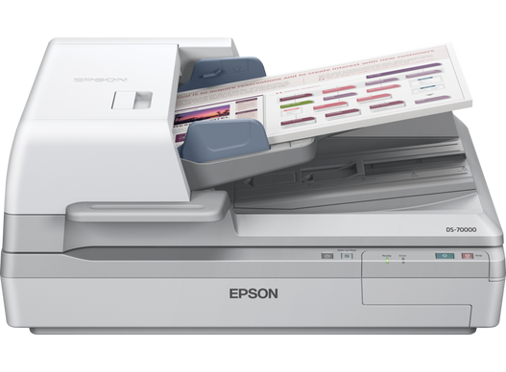
Document scanner

Slide 6
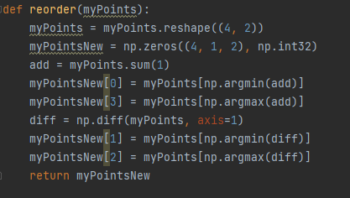
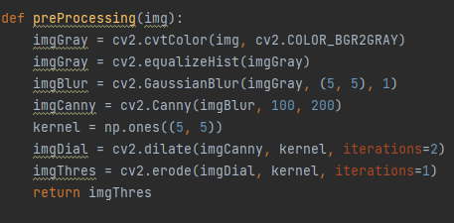
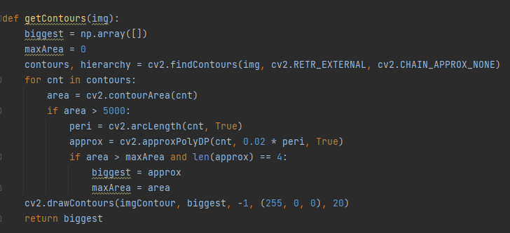
structure of the code
The program contains multiple functions:
preProcessing(): Preparing the image.
getContours(): Identification and selection of the largest rectangle.
reorder(): Arranging the order of the rectangle’s points.
stackImages(): Displaying multiple images in one view.
The entire process runs in real-time with the camera feed, displaying the final result in a separate window.

Slide 7
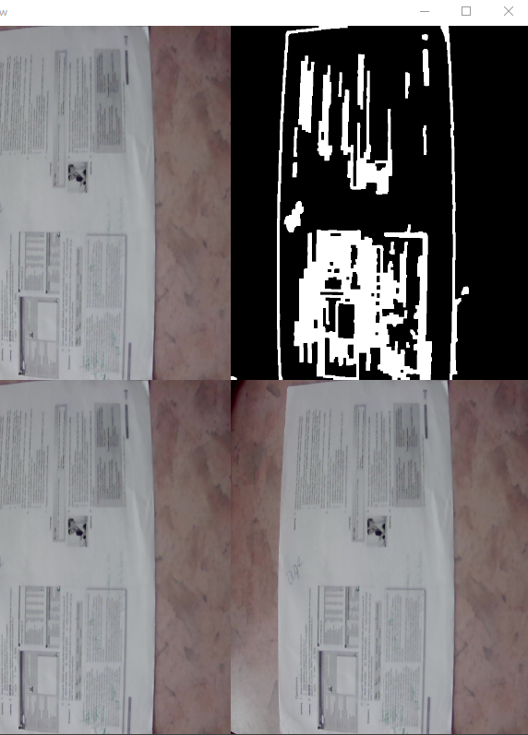
the testing of the code
We verified that the program runs stably and correctly identifies the rectangles visible in the camera feed.
Error handling ensures that image scanning issues do not cause crashes.

Slide 8
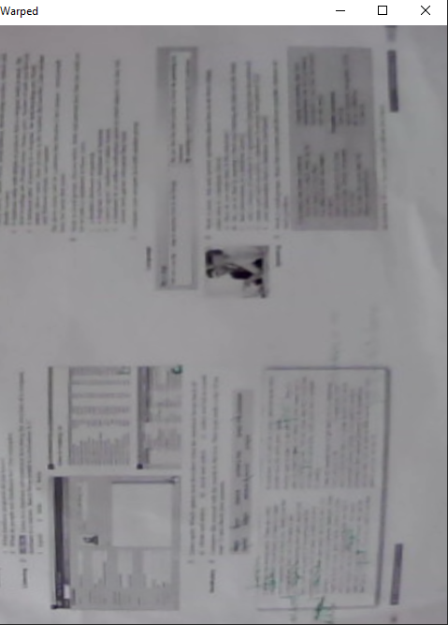
The introduction of the program
The program processes camera images to identify rectangles and "smooths" them using perspective transformation.
The steps of image processing include: preparation, contour detection, perspective transformation, and displaying images in one view.

Slide 9
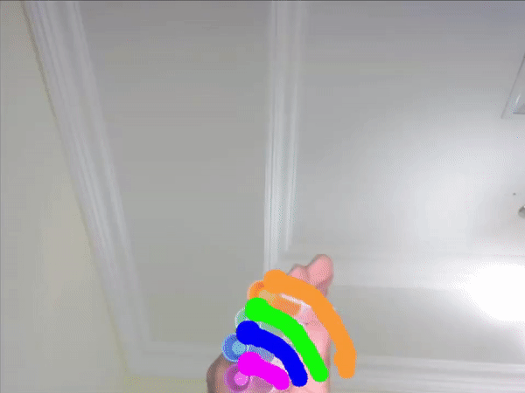
colour recognition program

Slide 10
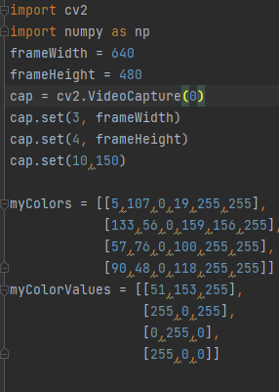
Code structure
Start camera, set screen resolution, adjust brightness
Colour definition

Slide 11
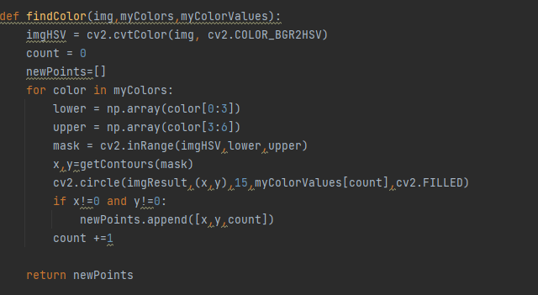
Search for a colour in the image according to the colour schemes defined in the list
Creates the colour filter (mask).
searches for contours in the mask.
For each colour found, draws a circle on the image. The function returns a list containing the coordinates and indexes of the colors.
The function returns a list containing the coordinates and indexes of the colors.

Slide 12
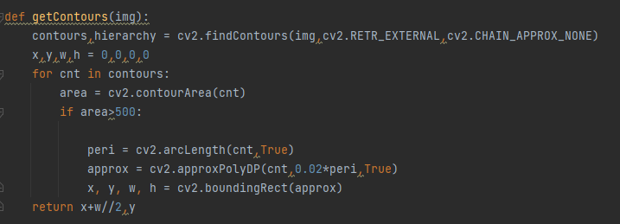
The cv2.findContours() function is used to find the contours in the input image.
Use cv2.arcLength() to calculate the circumference of the contour.
The cv2.approxPolyDP() function makes an approximation of the contour to get a more accurate shape.
Return the centre of the rectangle: x + w // 2, y
The cv2.boundingRect() function defines the rectangle surrounding the contour and returns the coordinates (x, y) and the width (w), height (h) of the top left corner

Slide 13
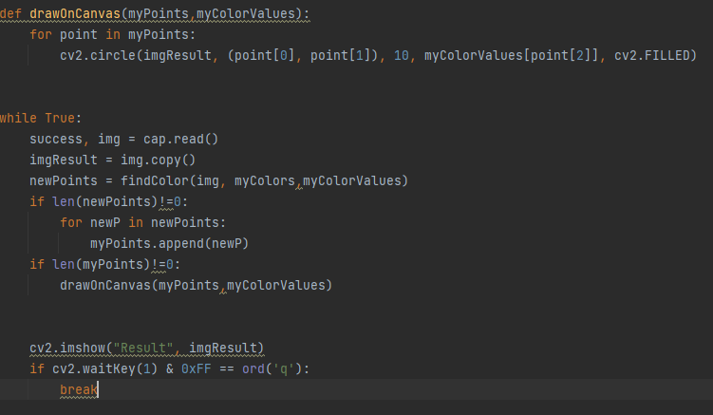
The img image is read using cap.read().
findColor(img, myColors, myColorValues) determines the new color values in the image.
The imgResult image is continuously updated and displayed using cv2.imshow().
Adds the new points (newPoints) to the myPoints list.
If there are points in the myPoints list, the drawOnCanvas(myPoints, myColorValues) function draws circles on the image with the corresponding colors.
cv2.waitKey(1) watches for keystrokes, and if the user presses the q key, it stops the program.

Slide 14
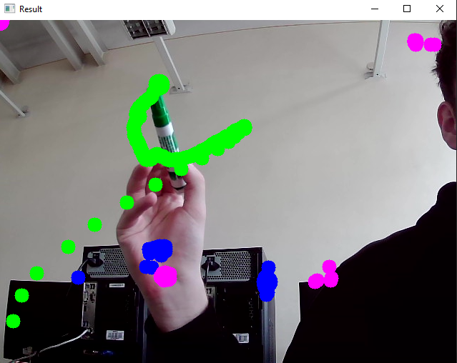
the testing of the code
The code base works but there is more to do

Slide 15
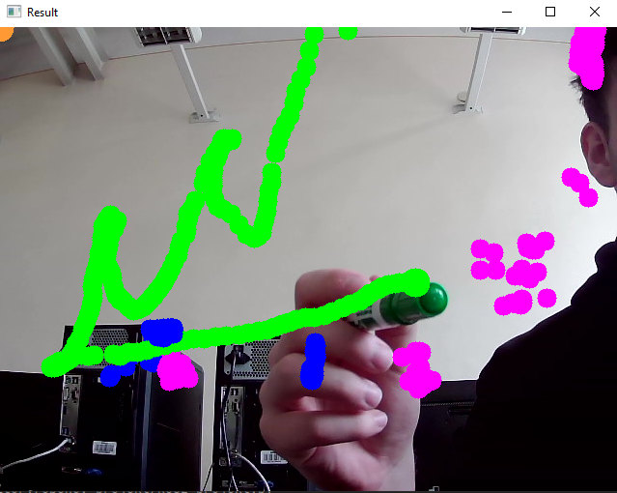
The introduction of the program
The program continuously monitors the webcam and detects the corresponding colours in each frame.
After detection, it draws circles on the image with the corresponding colours.
It follows the objects and displays on the screen the circles with the colours assigned to them.

Slide 16
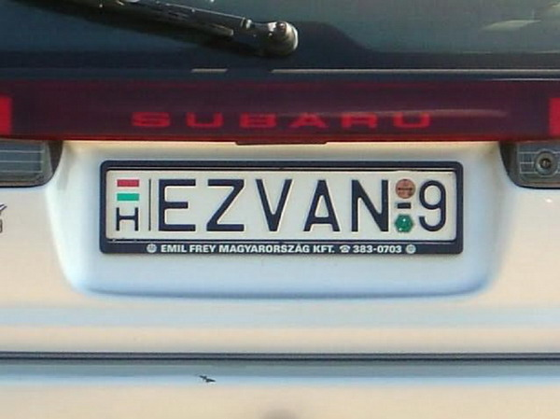
License scanner

Slide 17
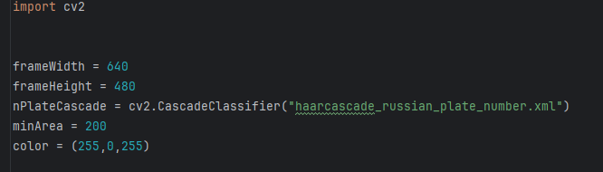
Code Stucture
Importing cv2: The cv2 module is part of the OpenCV library.
The Haar Cascade model is loaded, minimum area and color settings.

Slide 18
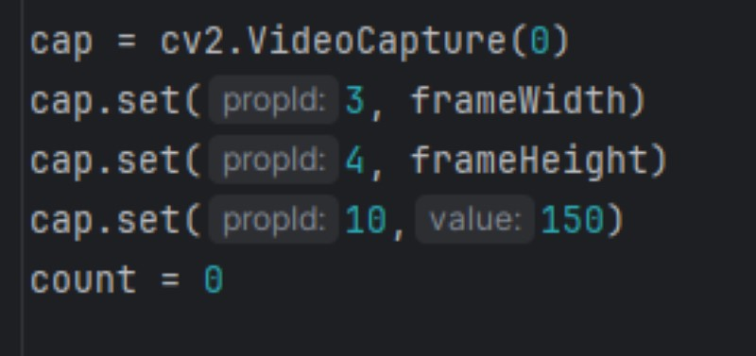
Code structure
Open video source
Setting camera properties

Slide 19
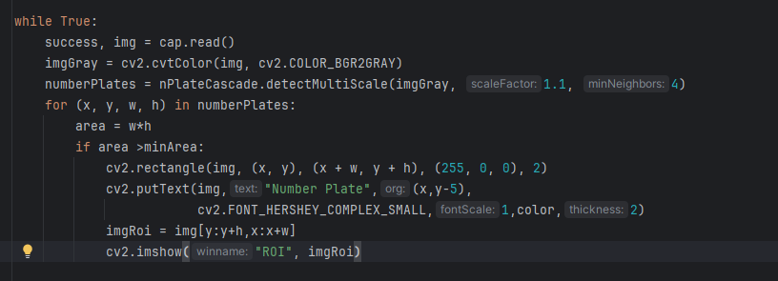
Code structure
Reading and converting an image
License plate detection
Examination of detected areas

Slide 20
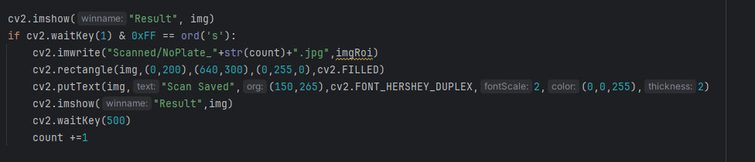
Code structure
Display images
Pressing the save button

Slide 21
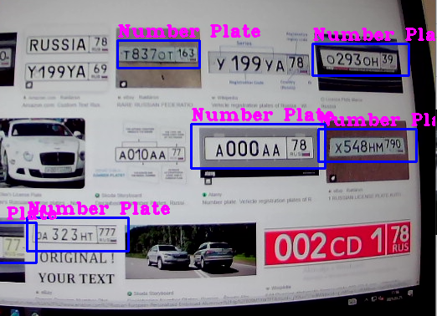
Code test
The test shows that if there is even a slight deviation or text close to the license plate, it does not recognize it; sometimes it doesn't even recognize it on cars.

Slide 22
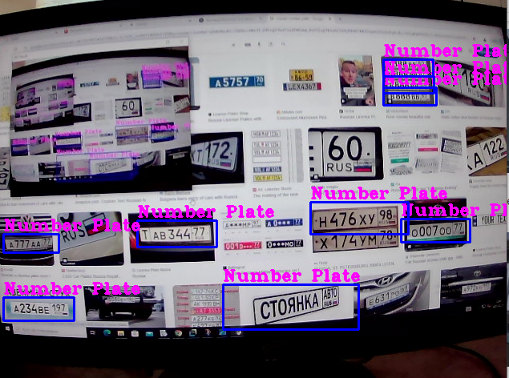
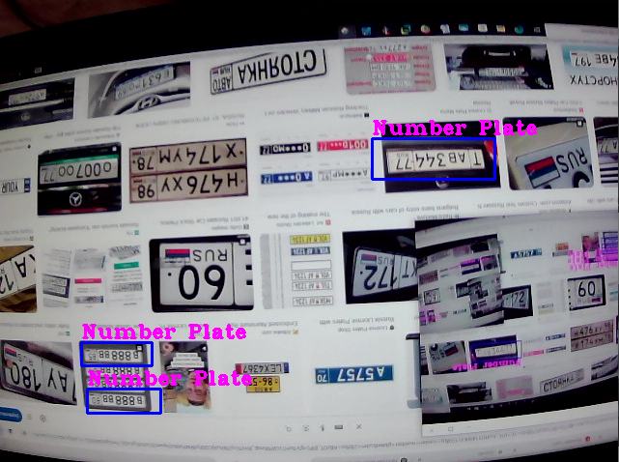
Code test
normal
From top to bottom
He recognizes fewer things upside down, but still manages to recognize quite a few.

Slide 23
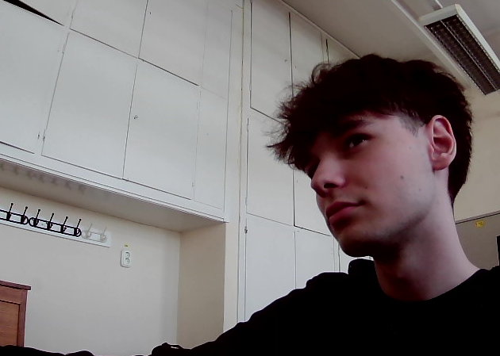
Code test
The program doesn't recognize me as a Russian license plate.
Me and marlon need to be stopped

Slide 24
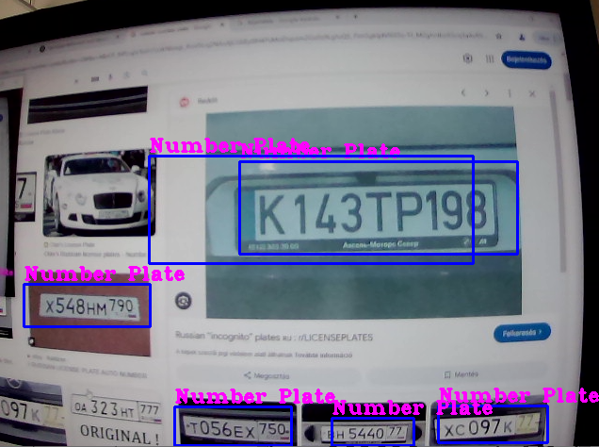
Program introduction
The program is a live video processing system that uses the computer's camera to recognize license plates. The operation is briefly as follows: Image collection: It continuously captures frames using the camera.Recognition: It identifies potential license plates using the Haar Cascade model.Display: If a license plate is found, the program visually highlights it, labeling it with the text of the license plate.Save: By pressing a key, it saves the found area to an image file.

Slide 25
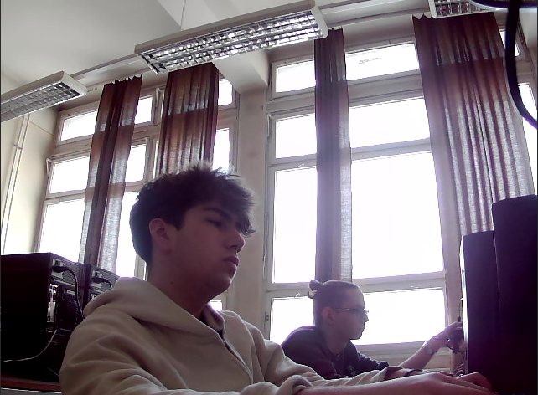
the end

